Slide 1





Team 2 P2X (Points to Everything)
SIEMENS
Hackathon
Huijo Kim Ankit Patnala Praise Thampi
{ huijo.kim, ankit.patnala, praise.thampi }@rwth-aachen.de​
Tung Dinh
tungdinh2821995@gmail.com
Anna Maria Wieliczek
a.mariaw@arcor.de
Notes:
Hi,
I’m Huijo Kim and I will present our project
Our team’s product is ‘Points to Everything’ so called P2X.

Slide 2
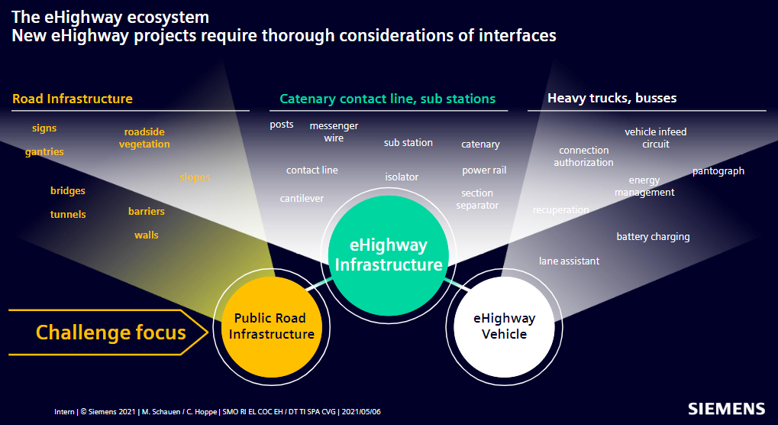
0. Challenge of the eHighway ecosystem
Notes:
eHighwway ecosystem face several challenges
Our product, P2X, can help to solve challenges in domain of public road infrastructure.

Slide 3
0. Challenge of the eHighway ecosystem
P2X (Points to Everything)
- Create segmented pointcloud for versatile purposes
- Improve the quality of planning
- Assist the drivier’s driving
Pipeline
Image
Segmentation
Point Segmentation
Extract valuable data
SLAM
Plan Trajectory
Share Cloud
Prototype demo
Concept demo
Notes:
Here is the objective of P2X.
It Create segmented pointcloud for versatile purposes.
And, it improves the quality of planning.
Also, it assists driver’s driving.,
Here is the pipieline of our product.
It consists of 6 parts, Image segmentation, Point Segmentation, Extract valuable data, Slam, Plan Trajectory, Share Cloud.
Due to the limited time, We are able to demonstrate the prototype of the first two parts.
Because these 2 steps are essential, next other 4 step could be solved soon.

Slide 4
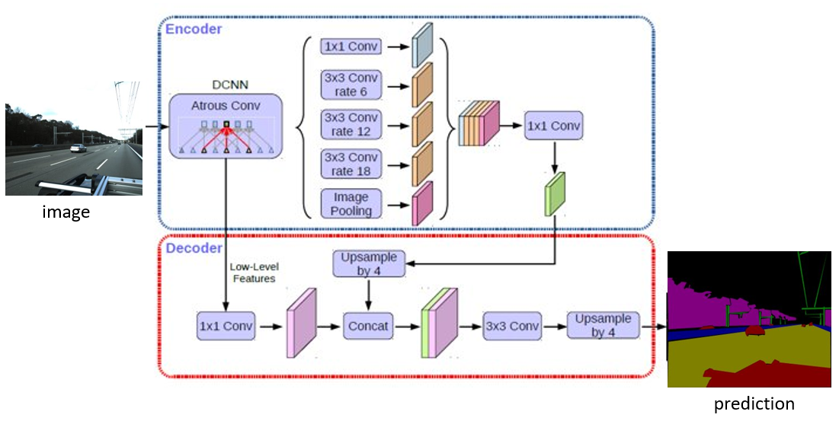
1. Image Segmentation
Share Cloud
Image
Segmentation
Point Segmentation
Extract valuable data
SLAM
Plan Trajectory
DeepLabV3 [Architecture]
Semantic Segmentation architecture
Atrous/Dilated Convolutions
Spatial Pyramid Pooling
Encoder-Decoder
Segmenting objects at multiple scales
Processing images of arbitrary size and
resolution.
No post processing techniques required
Resnet 18 [Backbone]
Liang-Chieh 2017, DeepLabV3
Notes:
DeepLabV3 is used for our semantic segmenation architecture
Also, we use Resnet 18 as our backbone network.

Slide 5
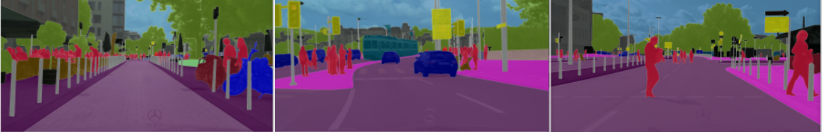
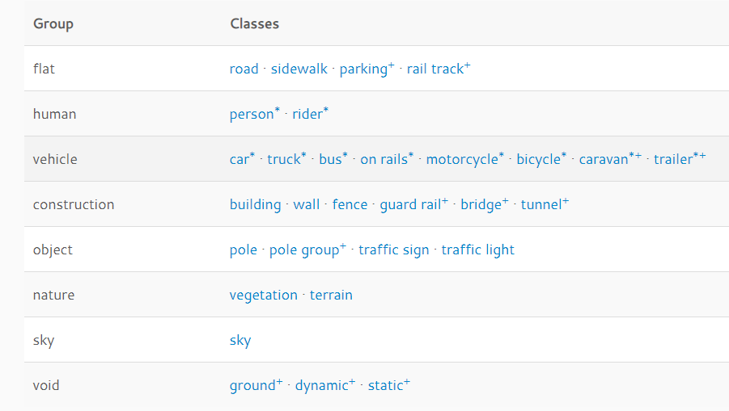
1. Image Segmentation
Share Cloud
Image
Segmentation
Point Segmentation
Extract valuable data
SLAM
Plan Trajectory
Pretrained with the Cityscapes Dataset due to the similarity with our image dataset.
Cityscapes
Notes:
We pretrained our DeeplabV3 model by using Cityscapes dataset.
This is because it is significantly similar to the given ehighway engineering datasets.
Especially, they share many object classes, such as pole, traffic sign, wall, and many others.

Slide 6
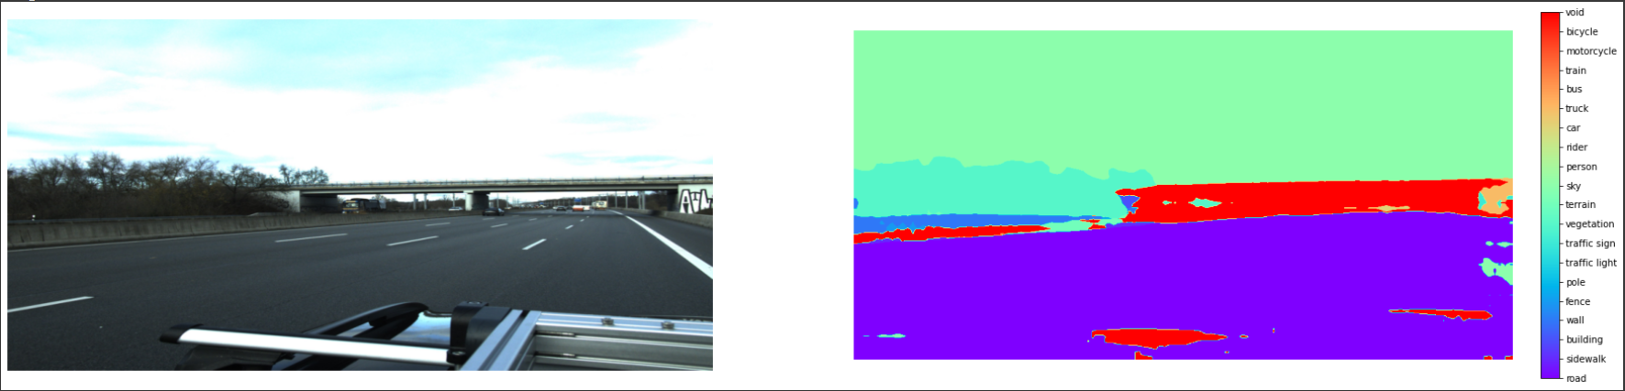
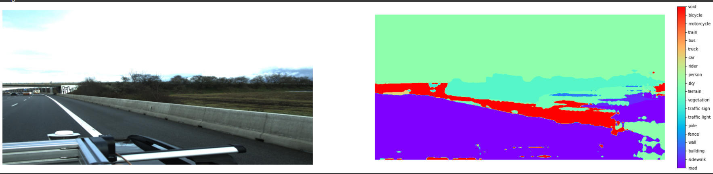
1. Image Segmentation
Share Cloud
Image
Segmentation
Point Segmentation
Extract valuable data
SLAM
Plan Trajectory
Feasibility with pre-trained model only - It performs generally good.
Better performance will be guaranteed with fine-tuning on manually annotated dataset.
Generating annotated data (Future plan)
Notes:
Our model could produce moderately convincing results – so, it proves the feasibility of our approach
it was ble to distinguish vegetation, road regions in image
If we can fine tune our model with annotated training data of ehighway, the better performance is guaranteed.
So, Generating annotated dataset is one of our future plan.

Slide 7
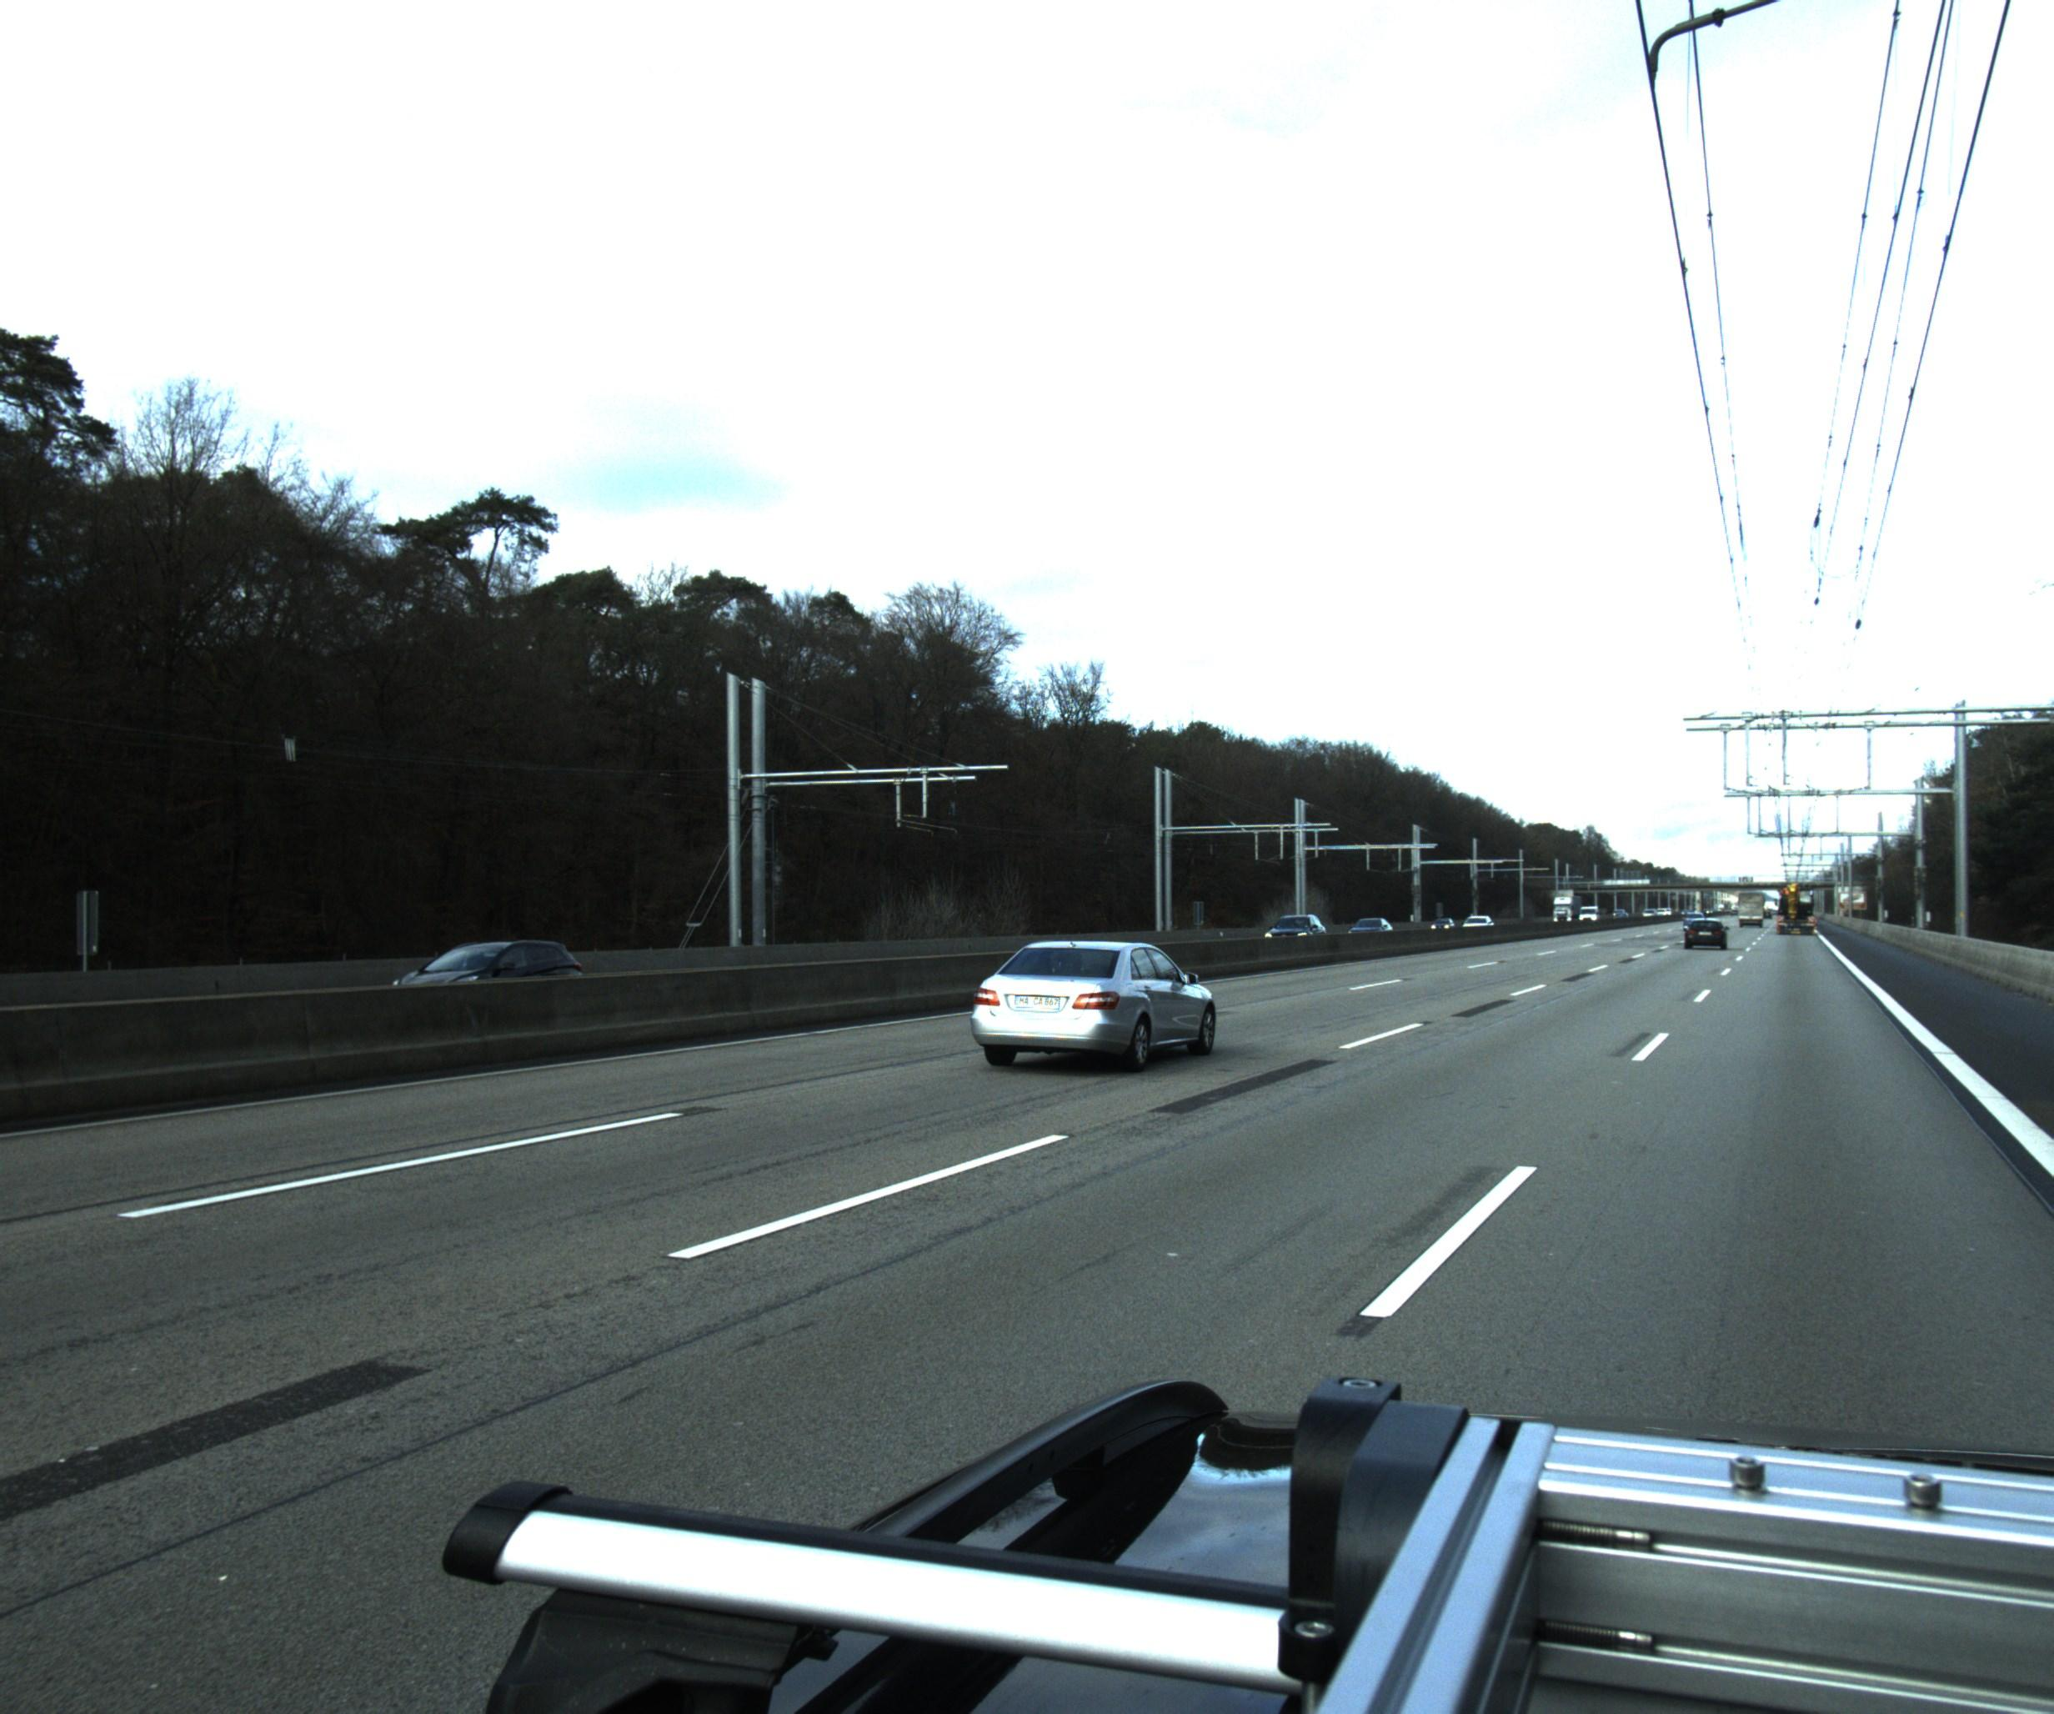
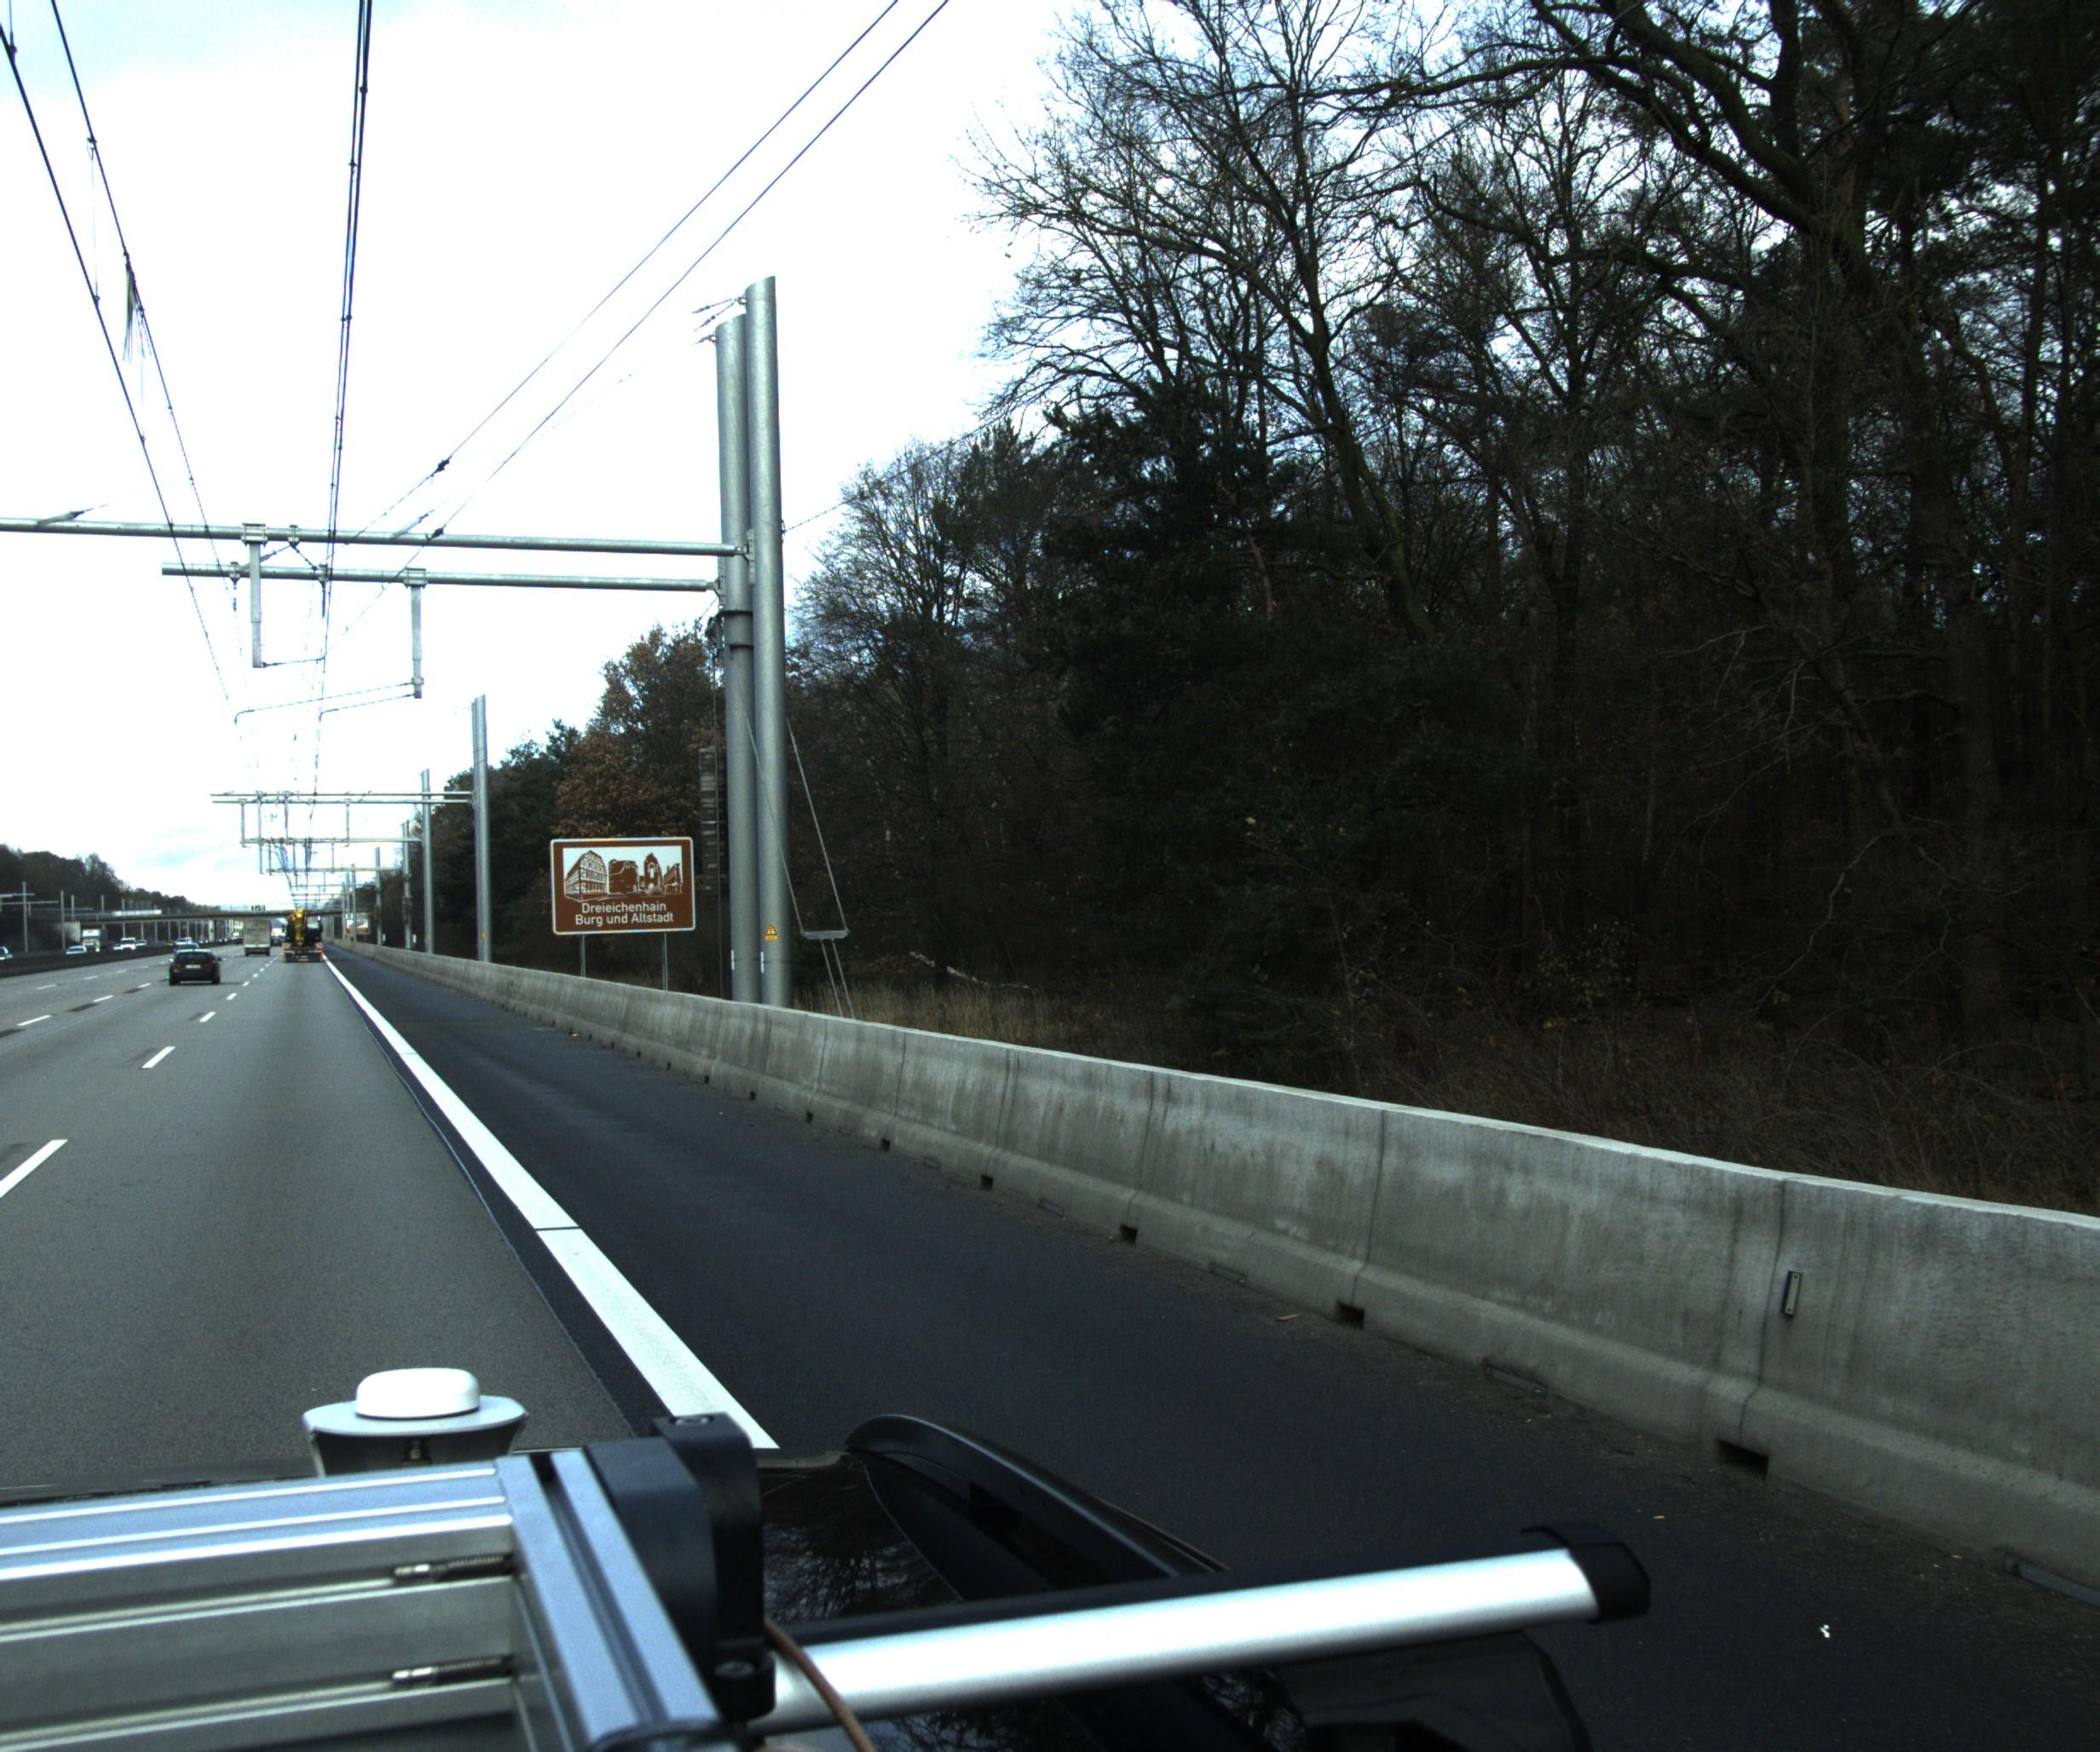
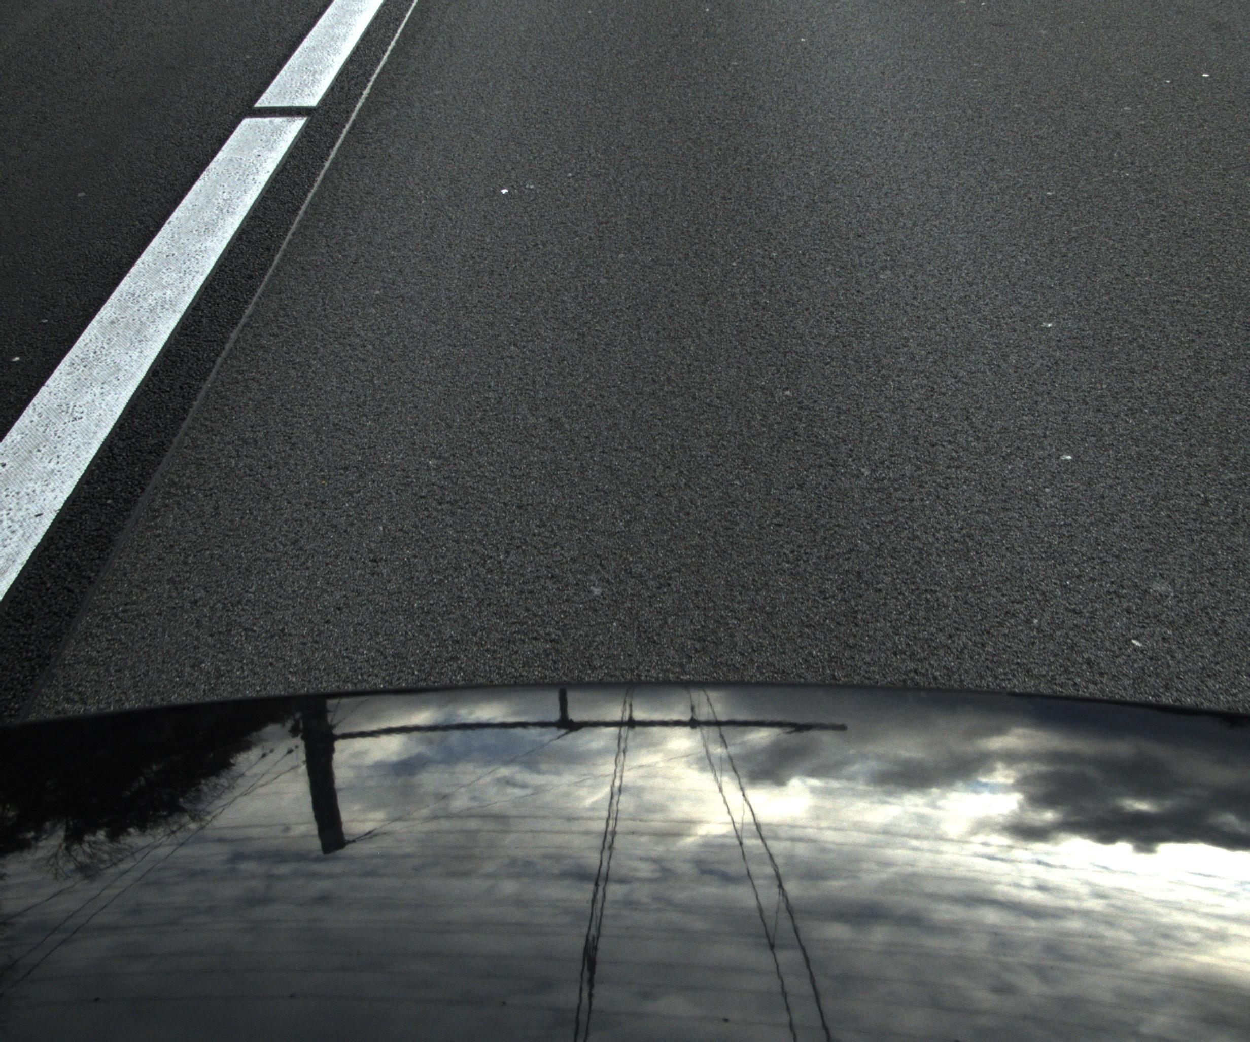
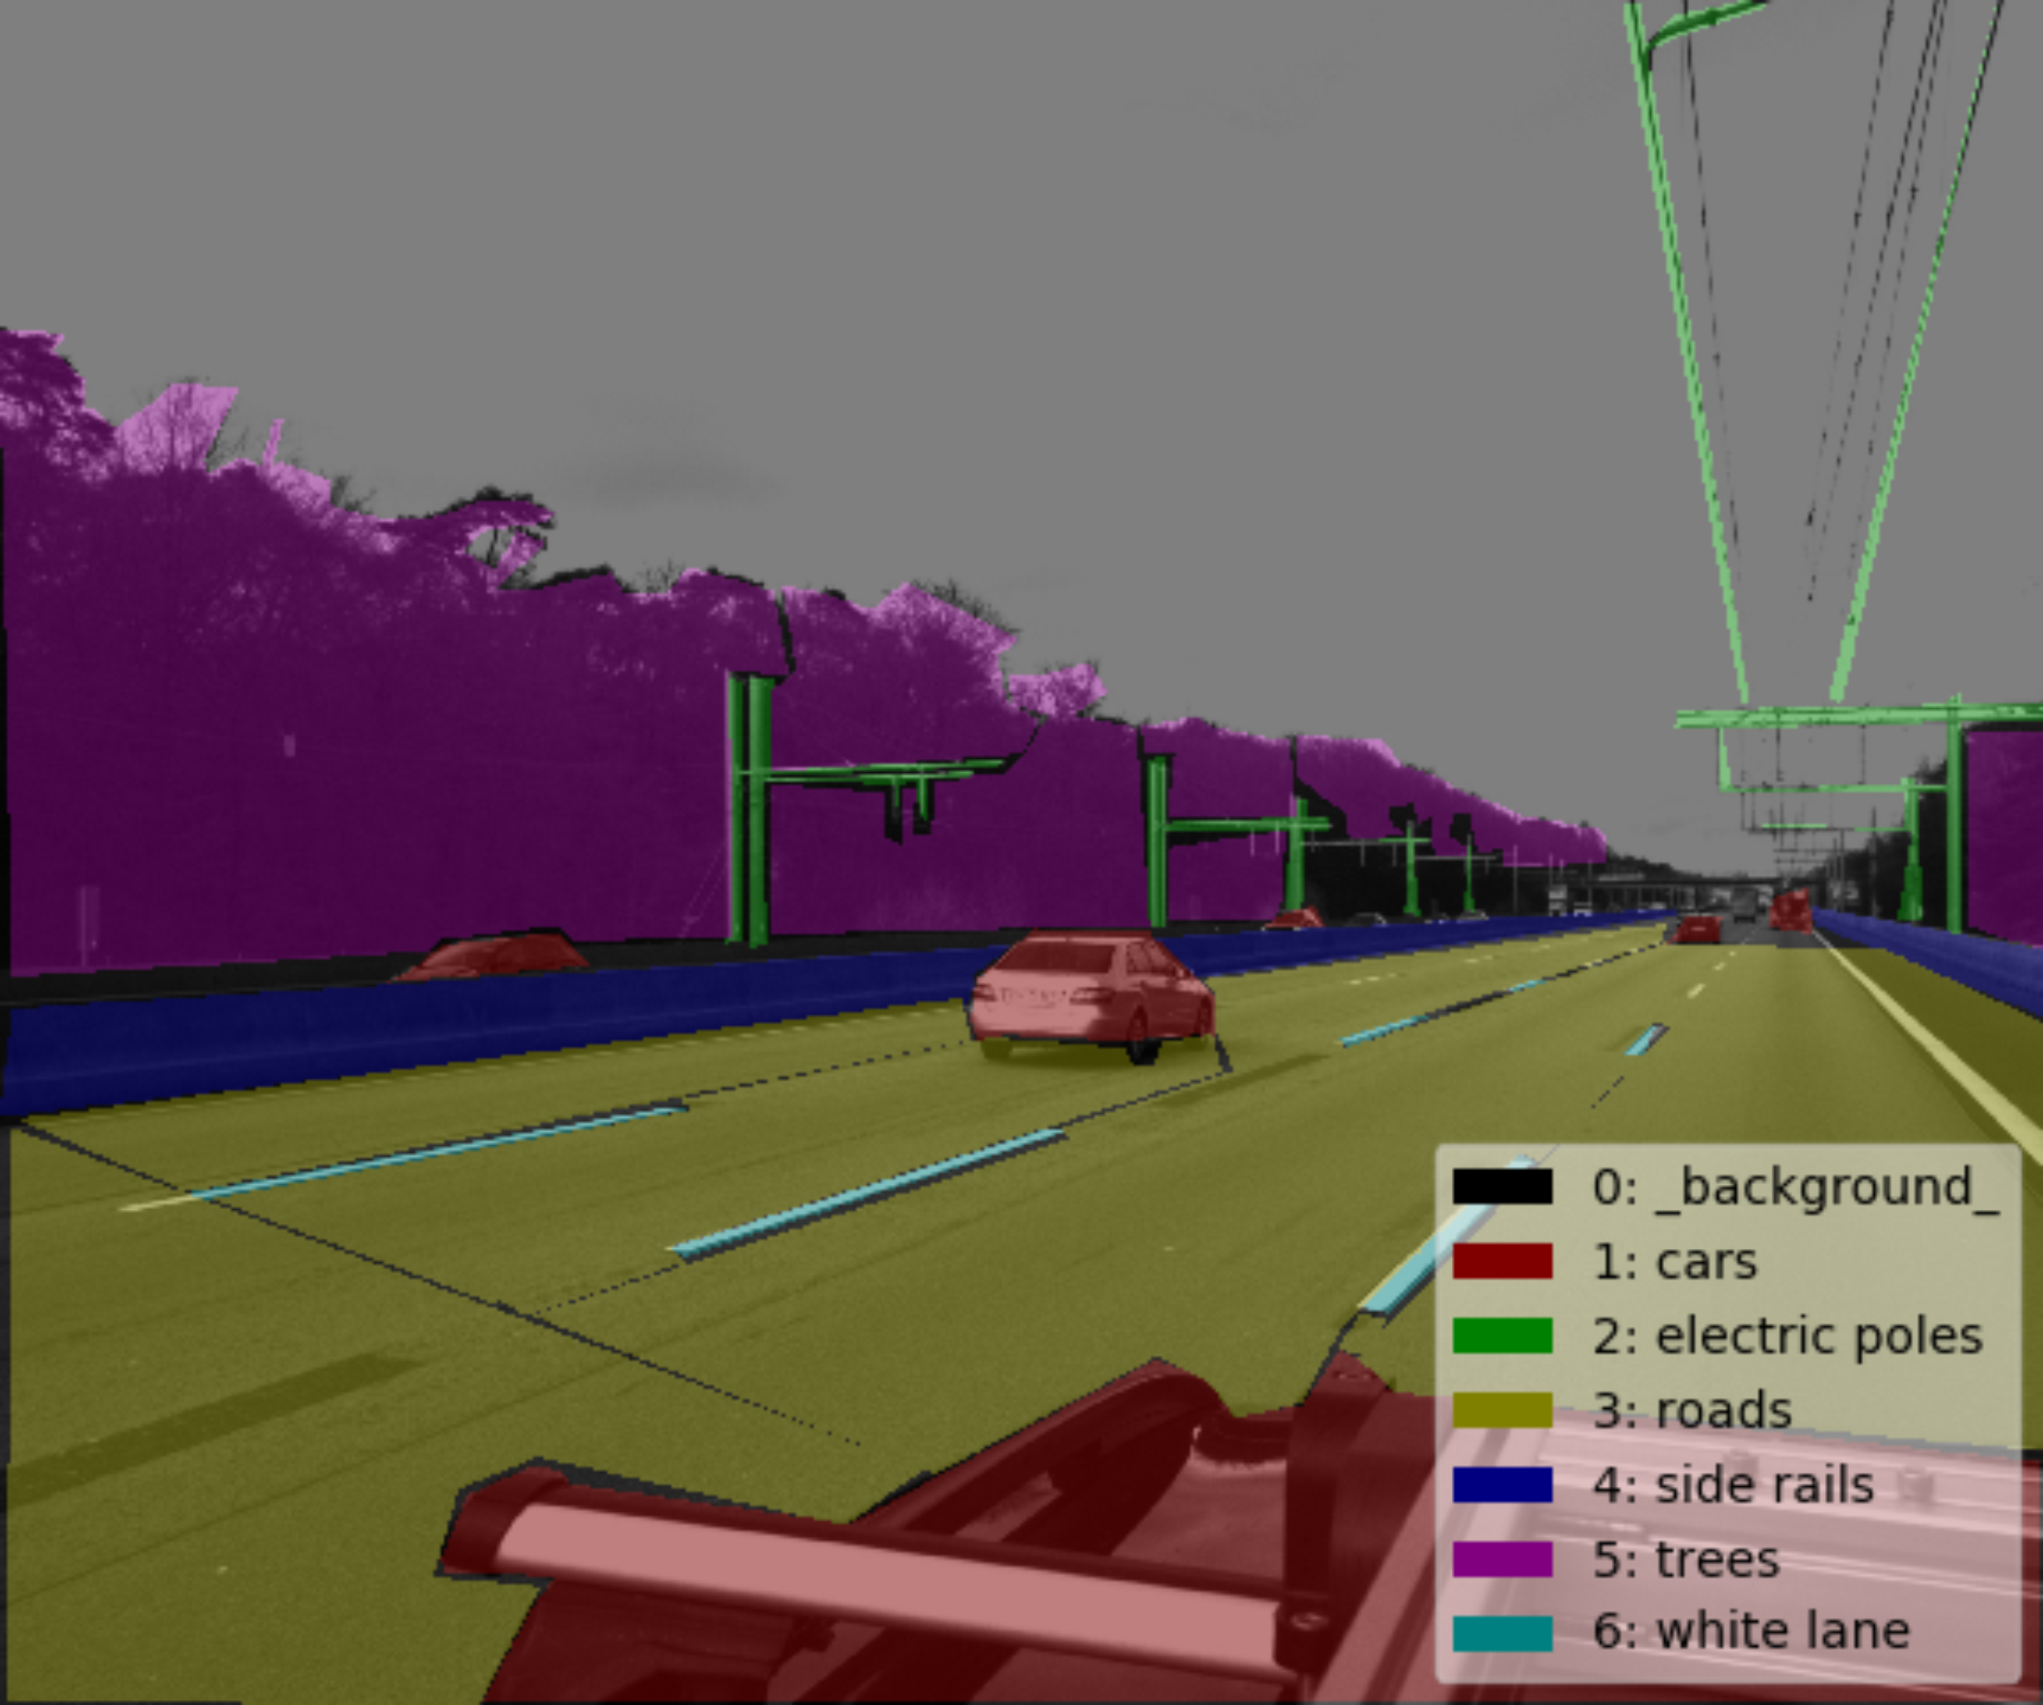
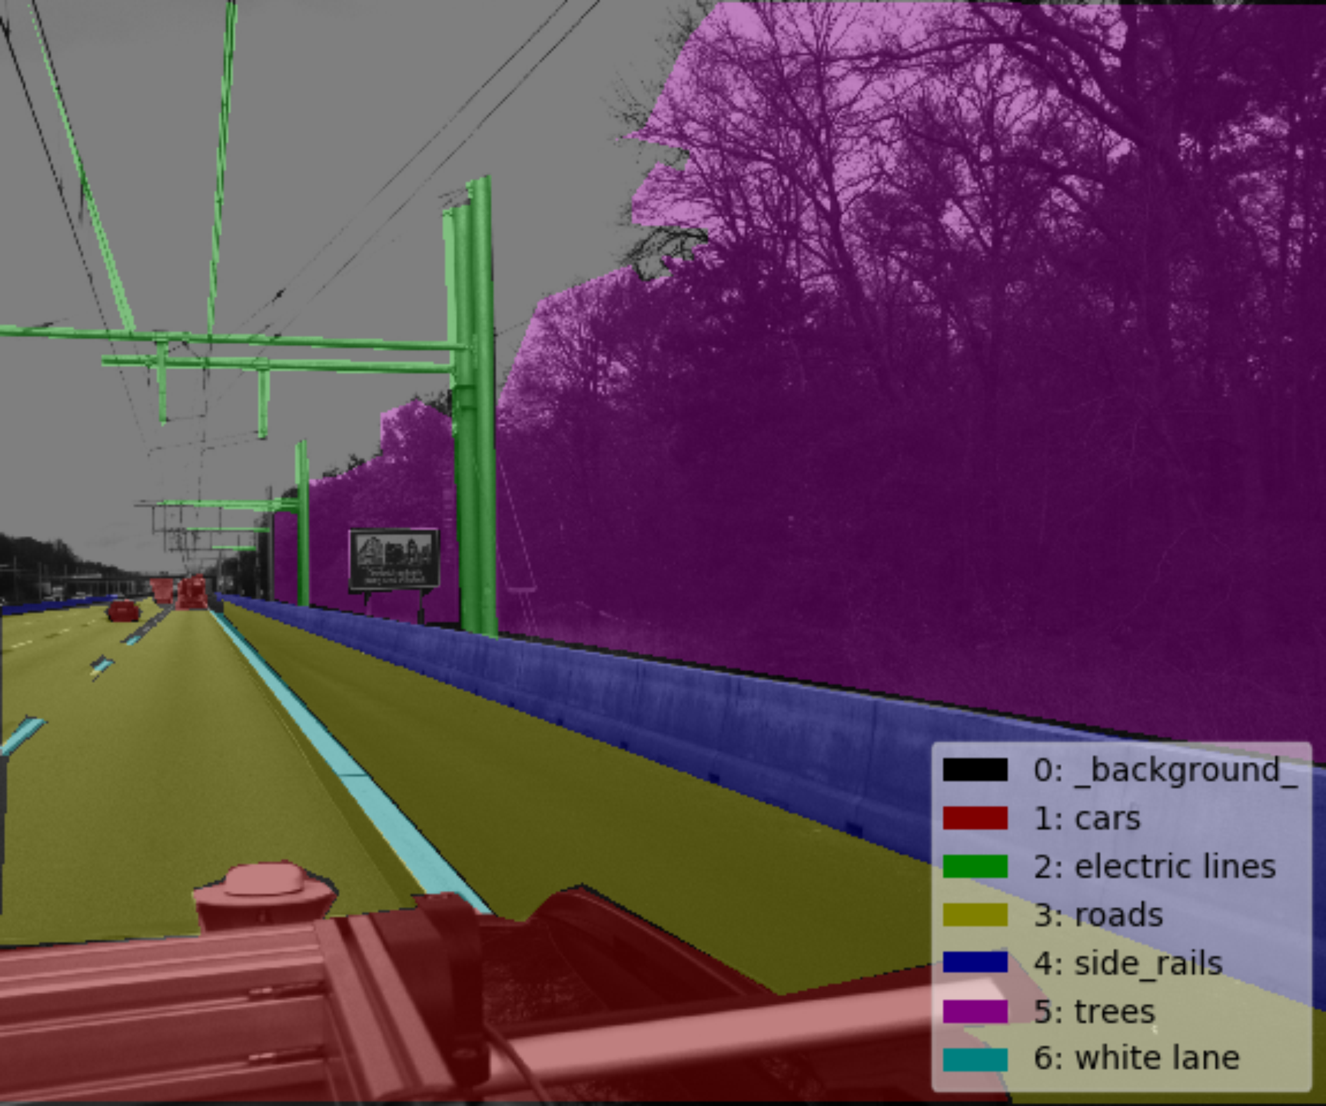
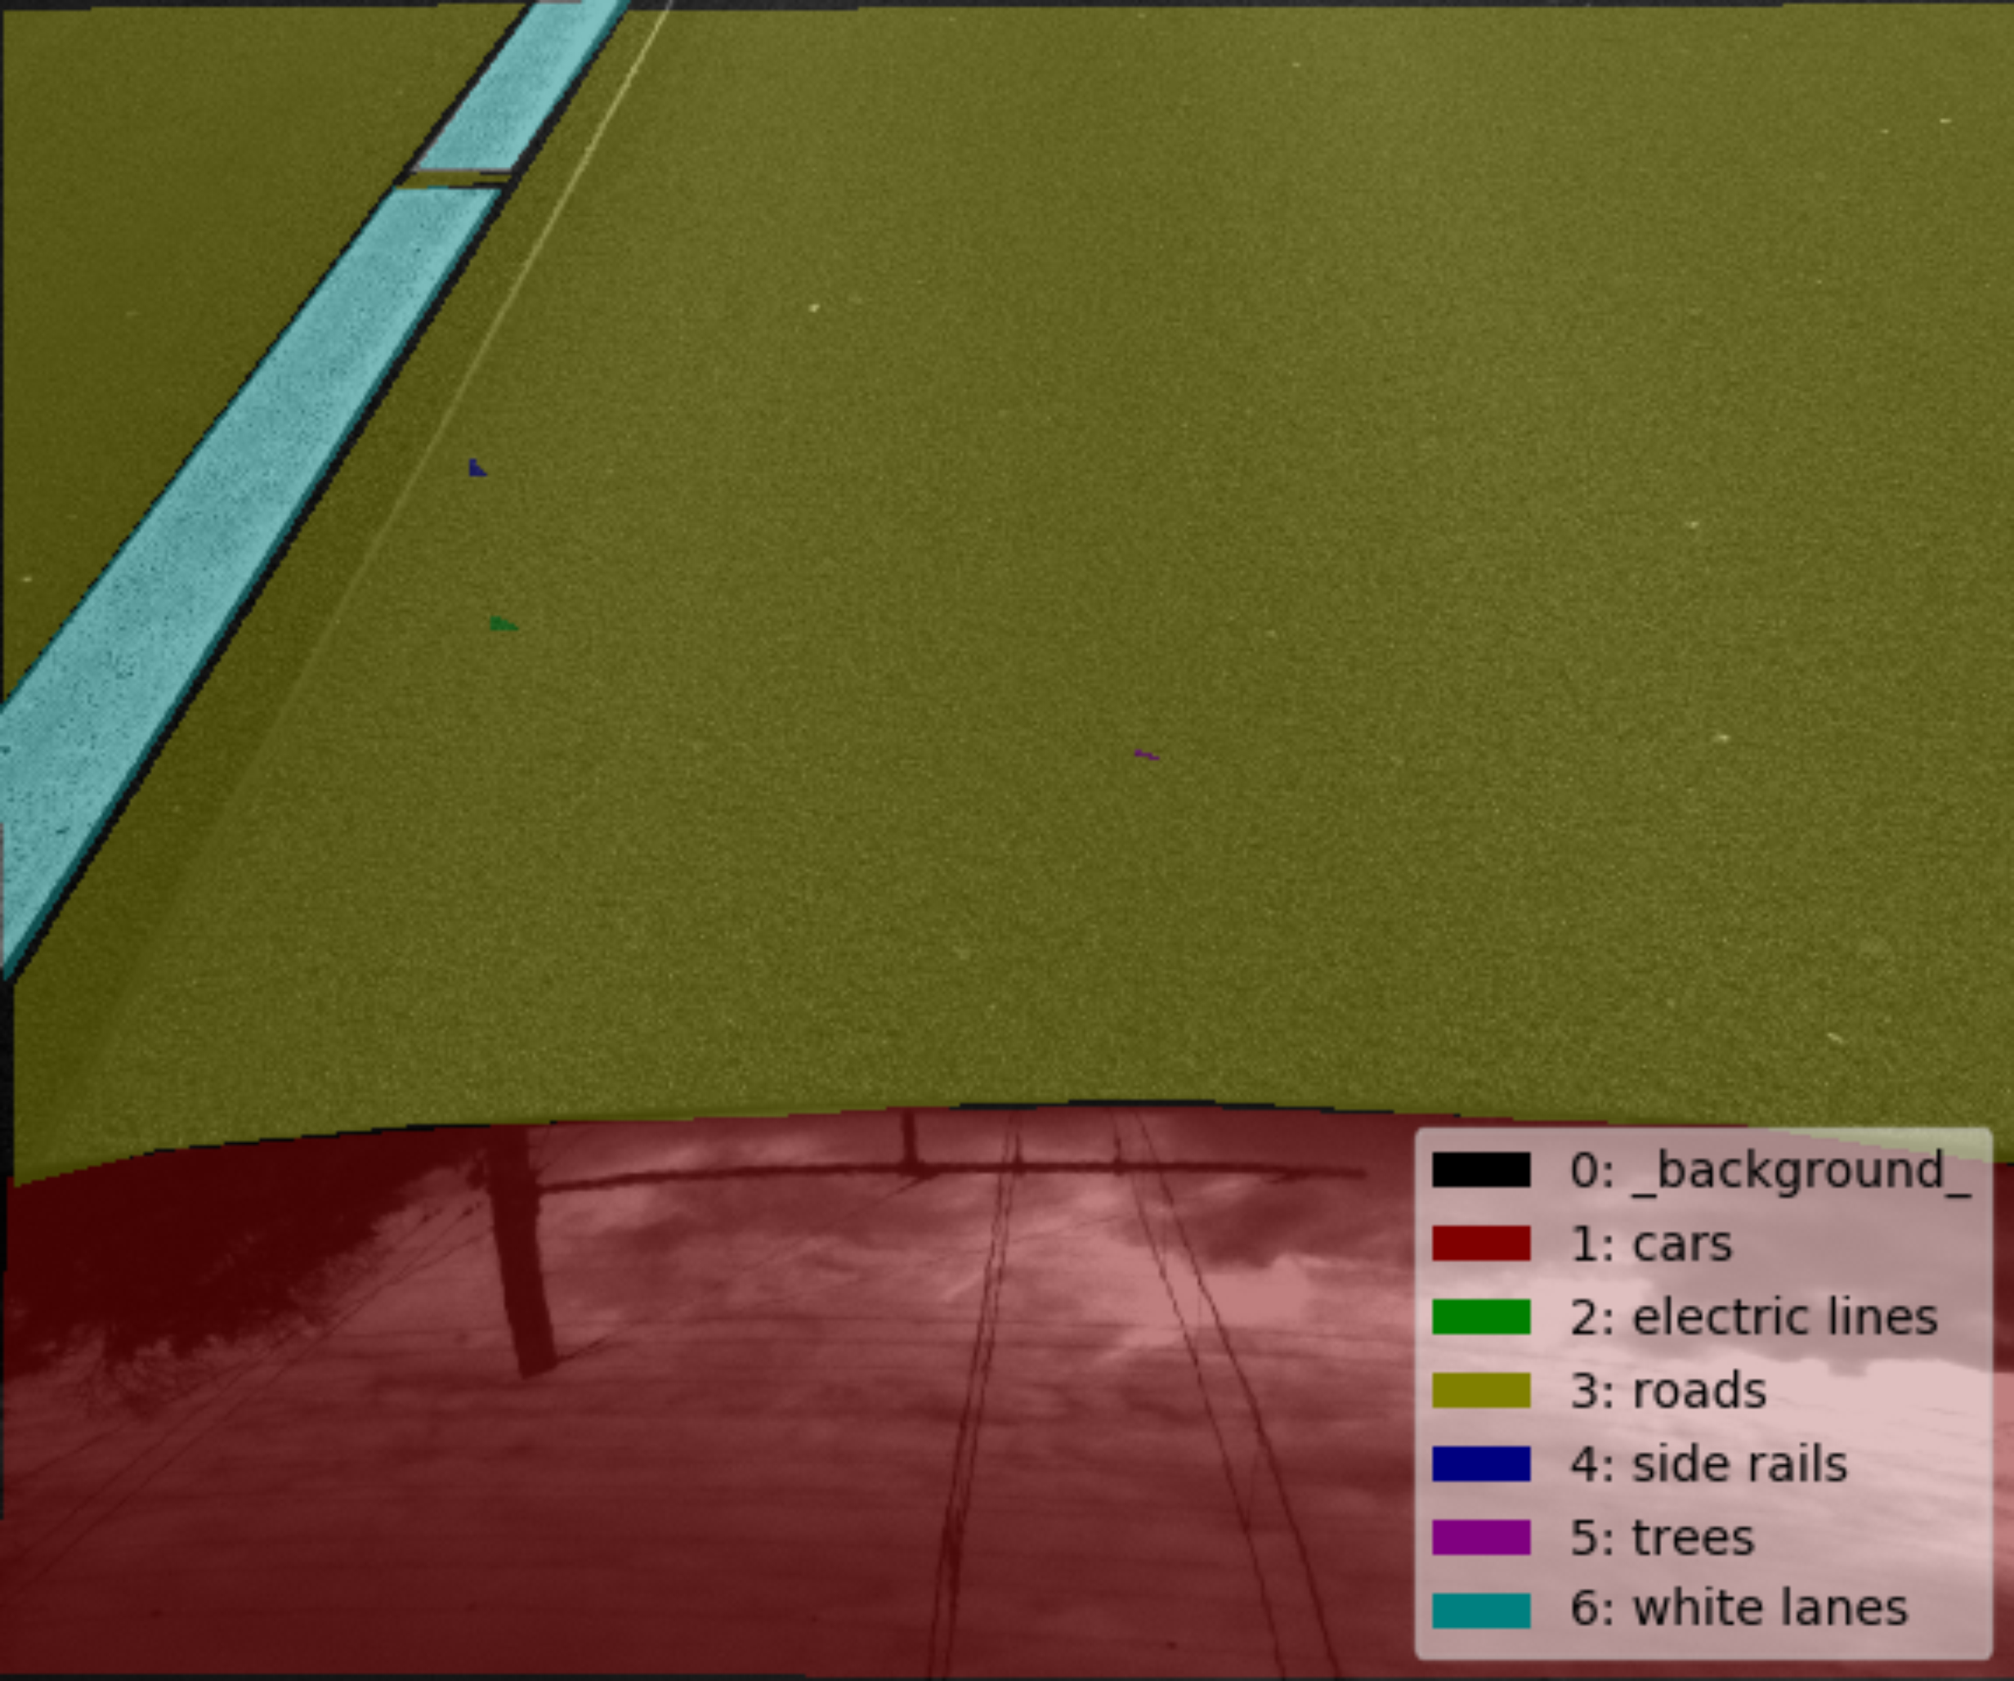
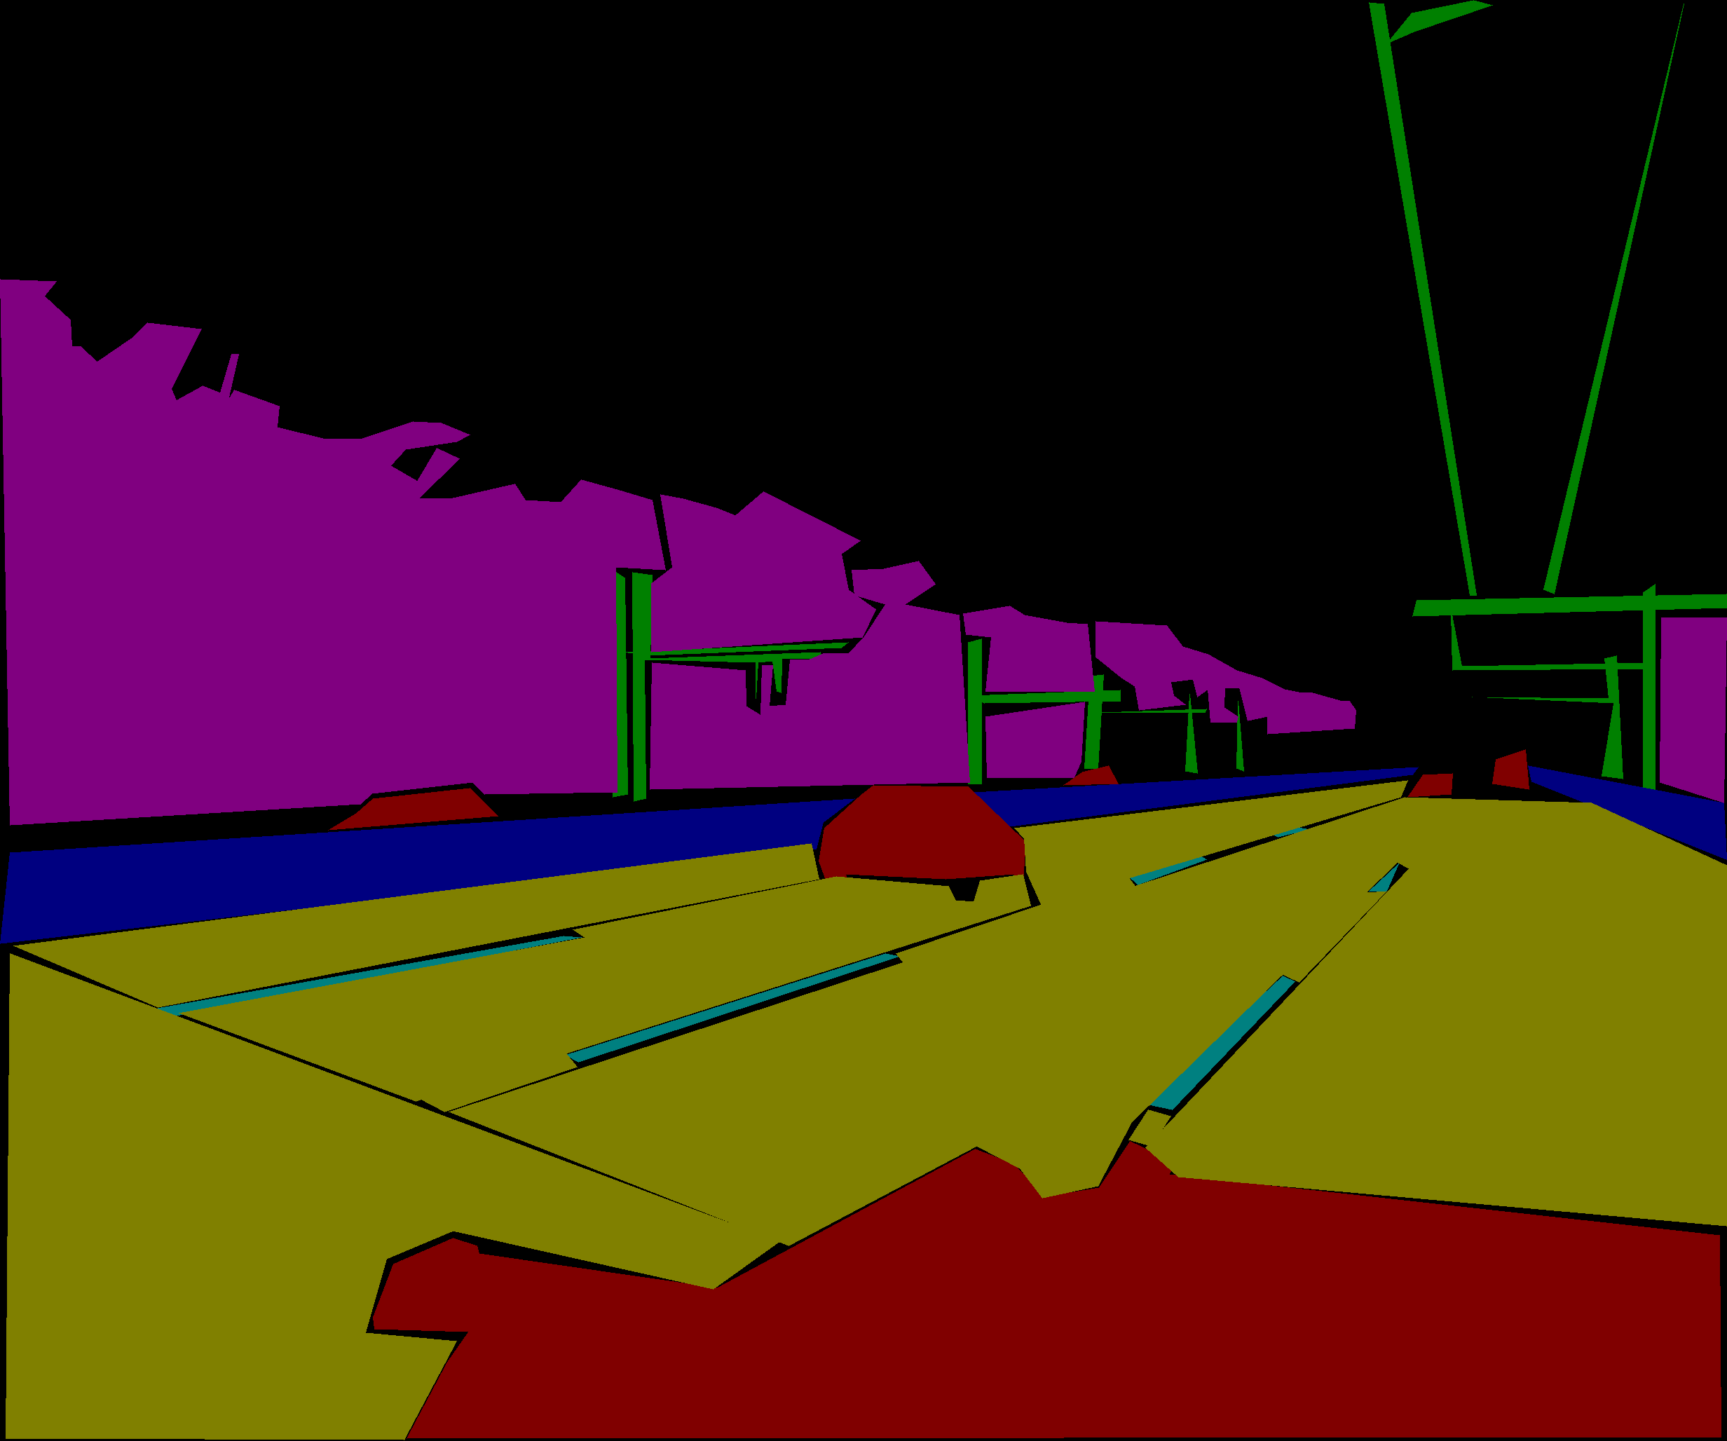
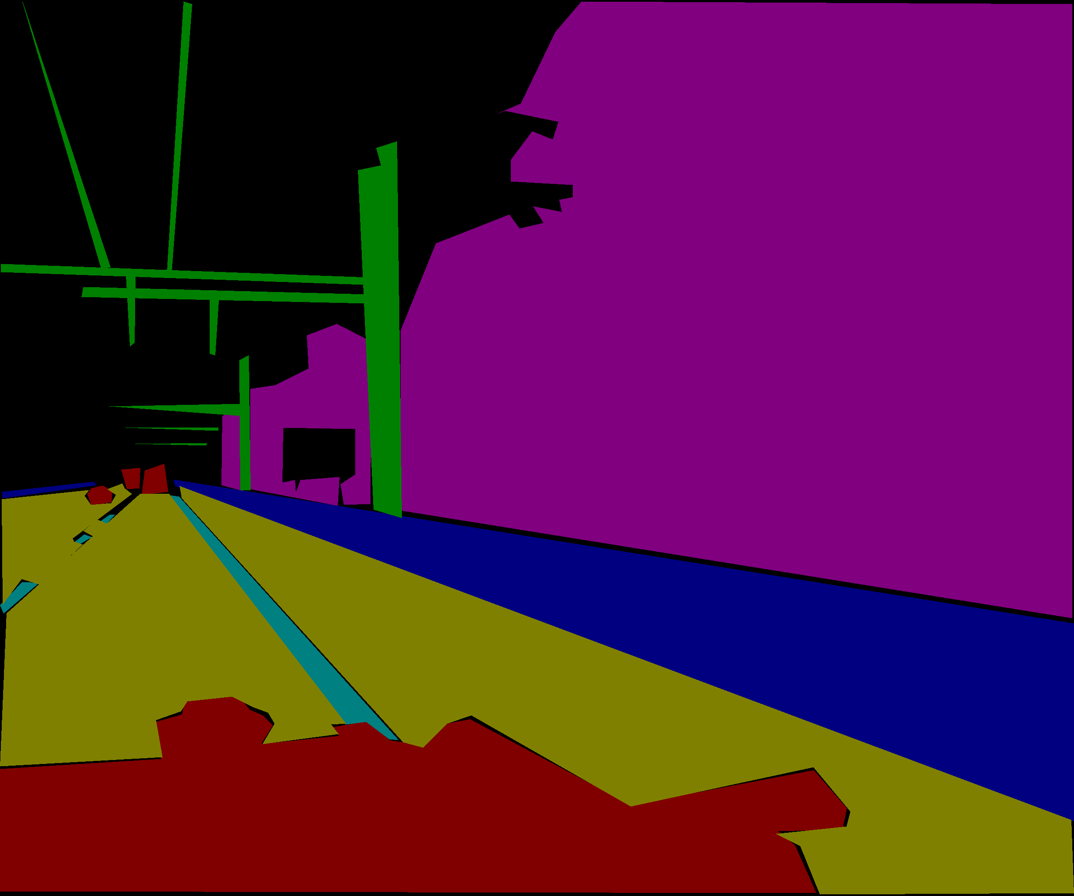
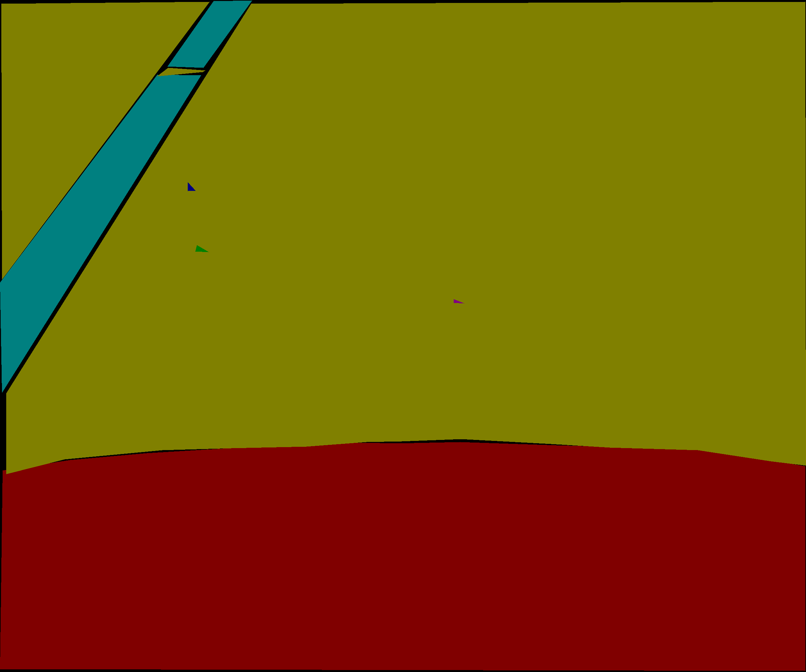
1. Image Segmentation
Share Cloud
Image
Segmentation
Point Segmentation
Extract valuable data
SLAM
Plan Trajectory
 | Image left | Image right | Image center
Input
Segmentation
Output
Notes:
In order to demonstrate the process of point segmentation, we use manually annotated dataset.
Input will be the image, and output will be classified pixels.

Slide 8
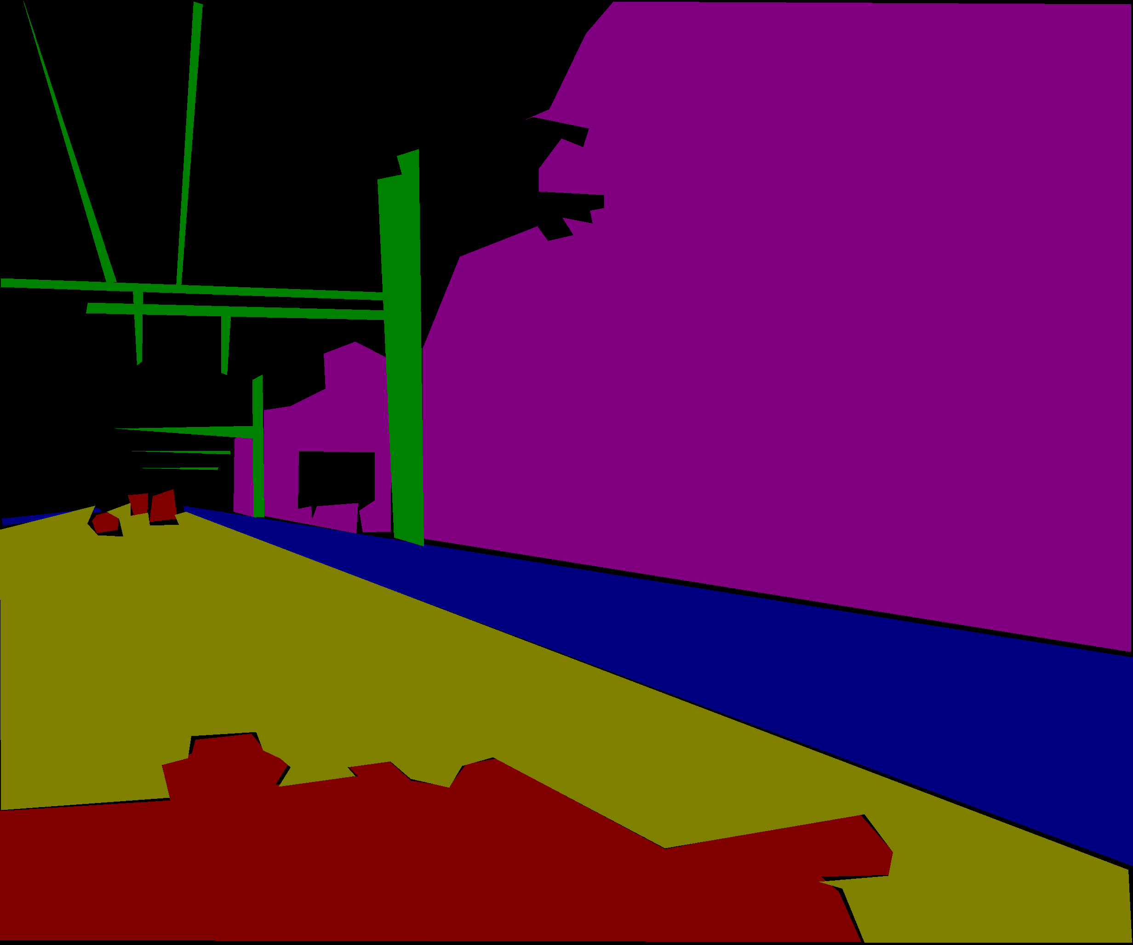
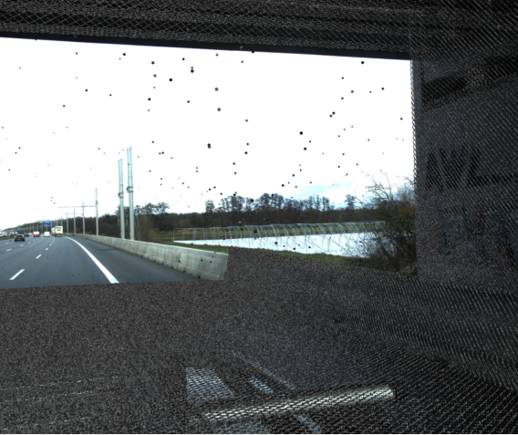
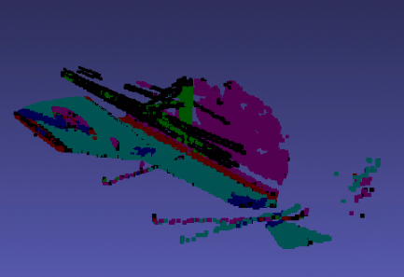
2. Point Segmentation
Share Cloud
Image
Segmentation
Point Segmentation
Extract valuable data
SLAM
Plan Trajectory
Segmented (Classified) Pixel
Projected
Unclassififed Point Cloud
Pairing
Reprojection (2D → 3D)
Notes:
Because we obtained segmented or classified pixel, when we project the unclassified point cloud into image plane,
We can relate each pixel and point. Therefore, each point can be classified.
Again, we have reprojected our point from 2D to 3D.

Slide 9
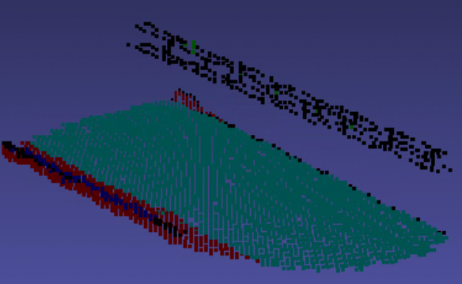
2. Point Segmentation
Share Cloud
Image
Segmentation
Point Segmentation
Extract valuable data
SLAM
Plan Trajectory
 | Point Cloud example 1 | Point Cloud example 2
Image
Demo Video
Notes:
This is the outcome of 3D reprojection.
Let me share the video shortly.

Slide 10
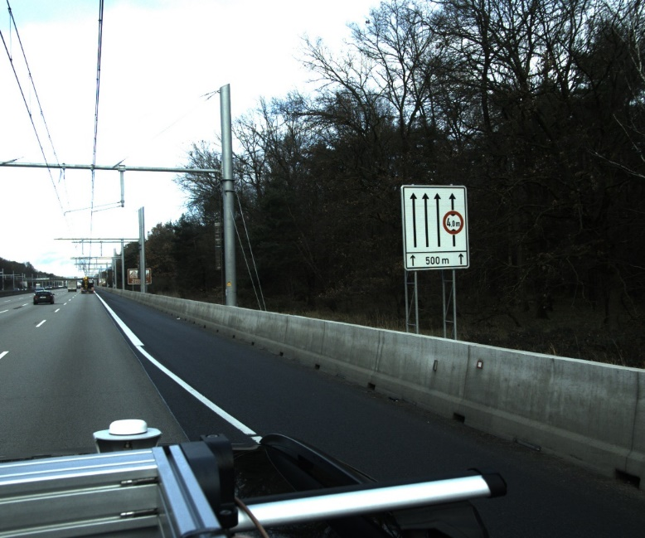
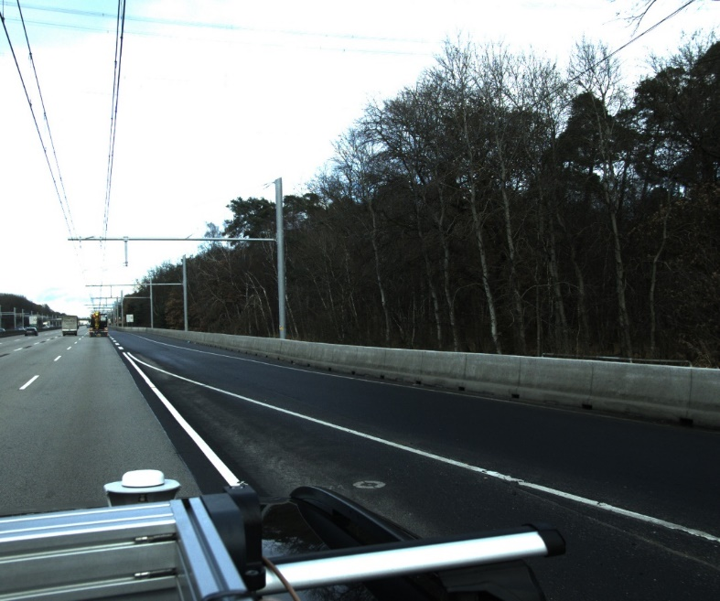
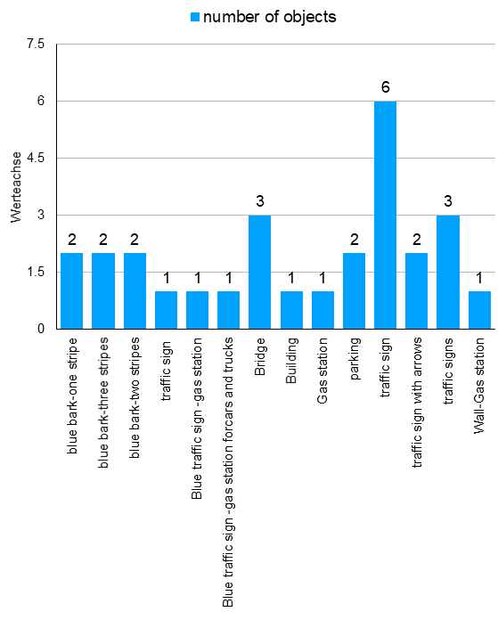
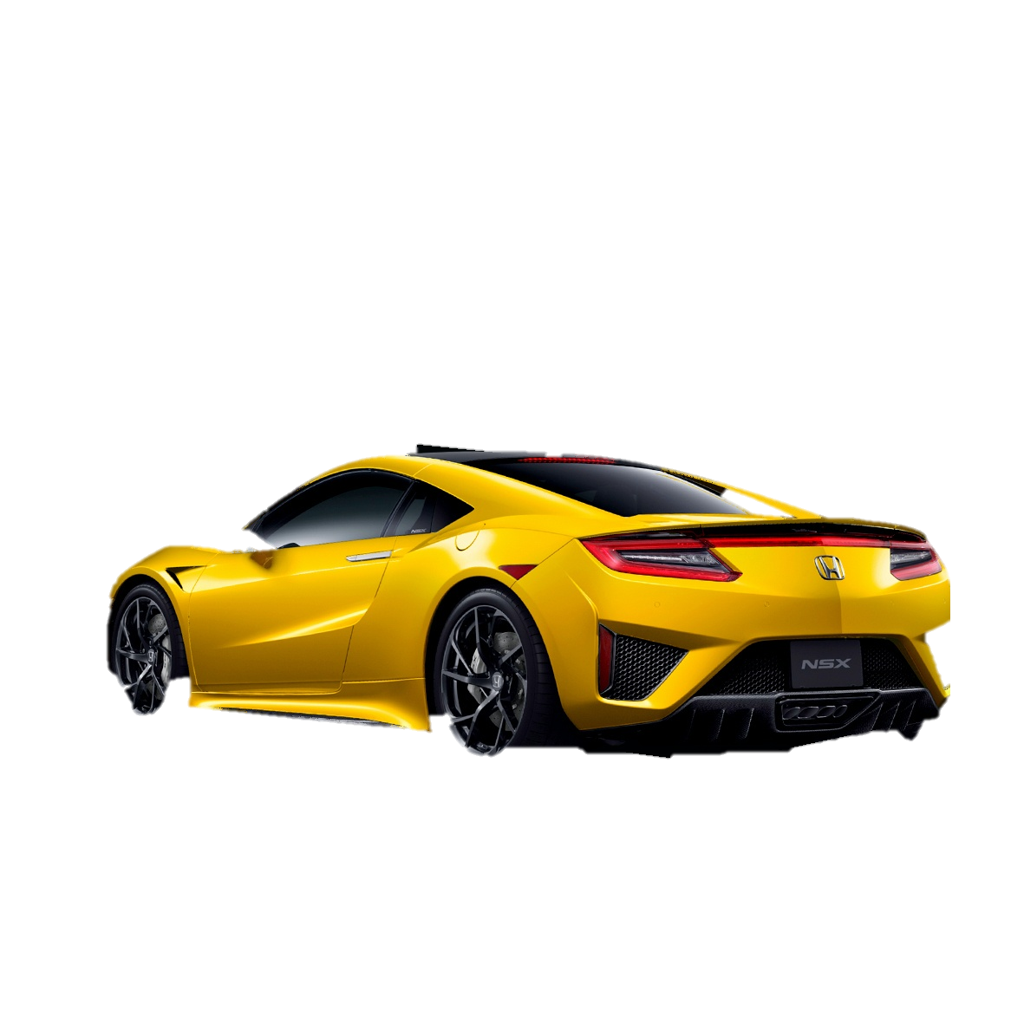
3. Extract Valuable data
Share Cloud
Image
Segmentation
Point Segmentation
Extract valuable data
SLAM
Plan Trajectory
Distance to the power cable
Sign
Monitor intervening vehicle
Distance to the wall
Using pointnet, measure key values
 | Distance to Wall | Distance to Lanes | ... | Economic Performance: 78 Safefy Performance: 85
avg | 5.2m | 0.6m
min | 1.2m | 0.2m
Notes:
The valuable data, such as distance between objects can be measured using point cloud segments via PointNet or Computational Geometry algorithms
Here, we can visualize the objects which the vehicle has captured as a graph.
Based on these statistics, we can evaluate economic performance and also safety performance of the driving.

Slide 11
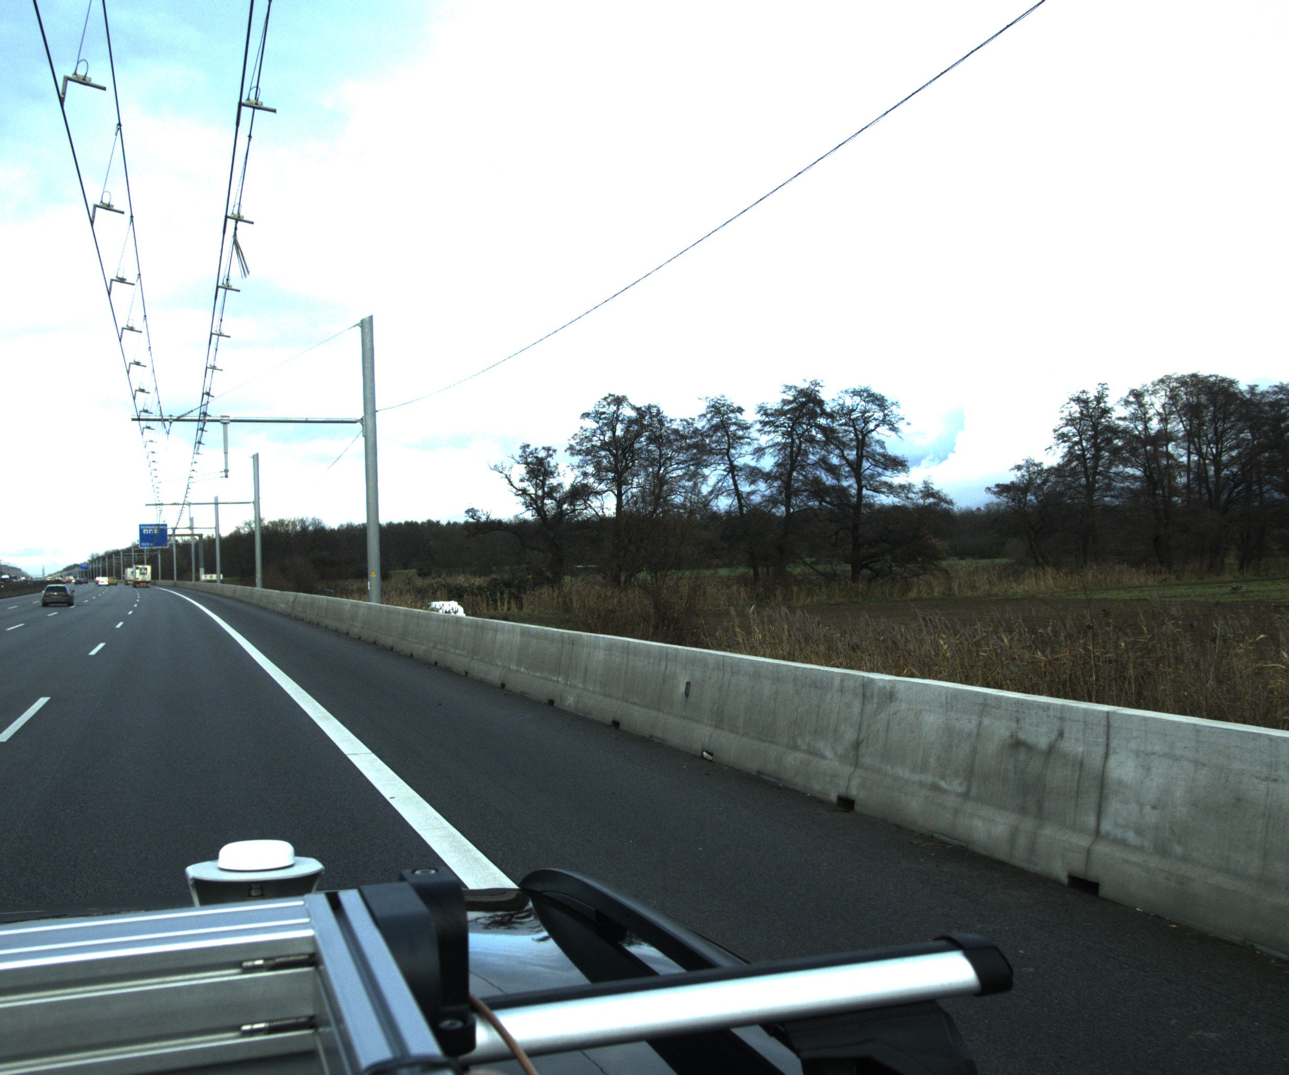
4. SLAM
Share Cloud
Image
Segmentation
Point Segmentation
Extract valuable data
SLAM
Plan Trajectory
The accuracy of vehicle’s GPS is 4.9 m.
However, distance between lane is 3m.
Therefore, the position of ego-vehicle should be enhanced by SLAM.
GPS data
Ego vehicle position from SLAM
3m
Dynamic model of Ego Vehicle
Kalman Filter
Accurate Ego vehicle position
Notes:
The accuracy of GPS is limited to approximately 5m.
But this is not enough because the distance between lanes are about 3m.
Therefore, the position of ego-vehicle needs to be enhanced by SLAM.
Because point cloud can detect well the landmark, it is very accurate.
So, in the end, Kalman Filter can fuse the position data using GPS, SLAM and dynamic model.

Slide 12
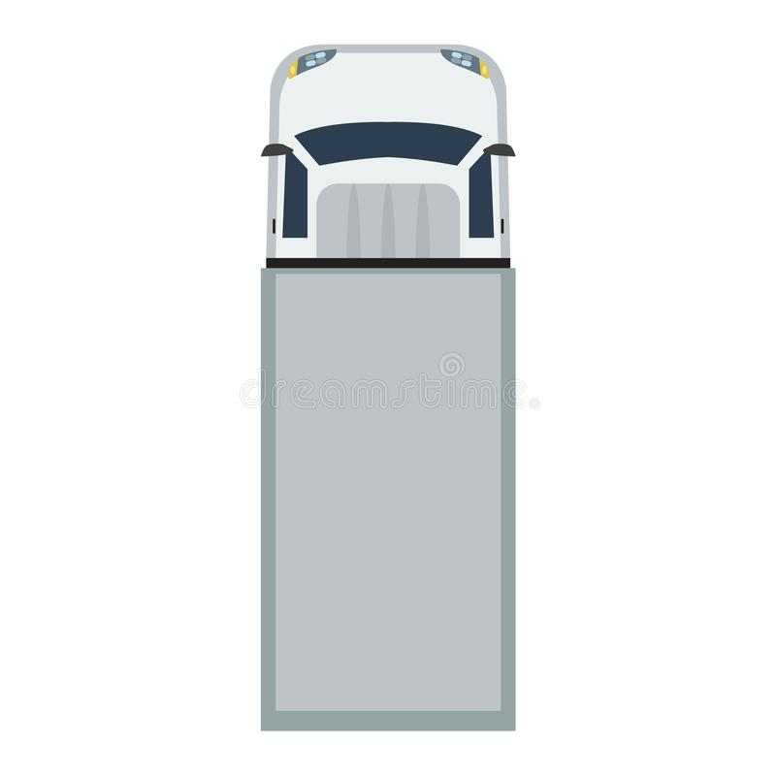
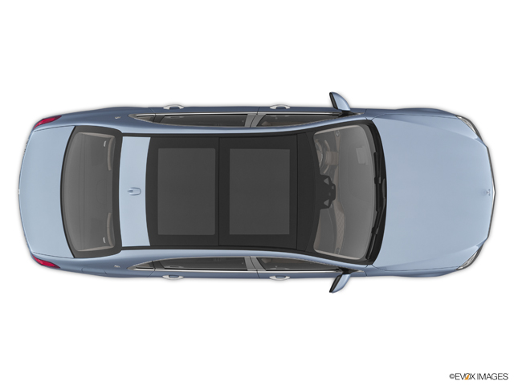
5. Plan trajectory
Share Cloud
Image
Segmentation
Point Segmentation
Extract valuable data
SLAM
Plan Trajectory
Following cars should fix the trajectory based on the real time data.
For example, when a car is intervening into between the trailing cars.
Here, Segmented point cloud data is very helpful to fix the trajectory.
Segmented pointcloud
Pointcloud annotation
Vehicle + line detection: pointnet
Line-changing prediction
Notes:
Let me demonstrate certain case.
If a car is intervening between the trailing our vehicles, segmented point cloud data is very helpful to dynamically fix the trajectory.

Slide 13
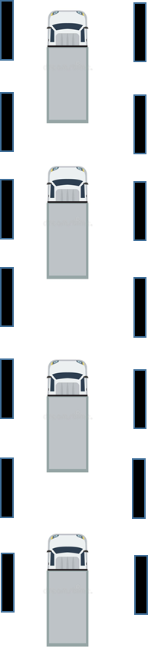
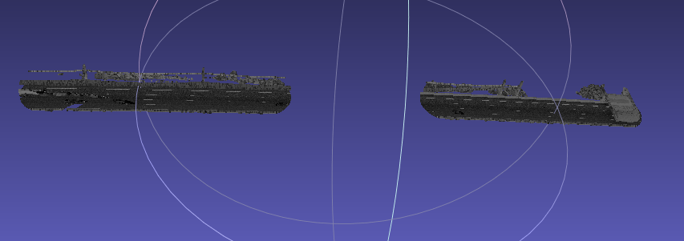

6. Share pointcloud Info
Share Cloud
Image
Segmentation
Point Segmentation
Extract valuable data
SLAM
Plan Trajectory
In case, multiple group of vehicles are driving on the same road, segmented pointcloud of a vehicle ahead can be used to plan the following vehicle better.
Notes:
In case, multiple group of vehicles are driving on the same road, segmented pointcloud of a vehicle ahead can be utilized to plan the following vehicle better.

Slide 14

Notes:
Thank you for your attention.

